Slide 1

SmartEdge Access: AI-Based Offline Face Recognition Door Lock System Using ESP32-CAM
An intelligent, offline face recognition system that combines edge AI with embedded security for next-generation access control
Name : Dasari Sowmya Sree
Reg. no.323129512009

Slide 2
Project Overview
The Challenge
The Solution
Key Benefits
Traditional access methods like keys, RFID cards, and PIN pads are vulnerable to theft, loss, duplication, and pose hygiene concerns in high-traffic environments
AI-powered offline face recognition system using ESP32-CAM and ESP-WHO library that unlocks doors securely upon successful facial identification
Complete offline operation ensures enhanced privacy protection, ultra-low latency response, and superior power efficiency compared to cloud-based alternatives

Slide 3

Why Face Recognition for Access Control?
Traditional Method Vulnerabilities
Hygiene & Convenience
Keys can be duplicated or stolen, RFID cards are susceptible to cloning and interception, while PIN pads suffer from shoulder surfing and brute-force attacks
Touchless operation eliminates hygiene concerns in public spaces whilst providing seamless user experience without physical tokens
Privacy-First Design
Fully offline processing addresses privacy concerns of cloud-based systems while maintaining fast response times and reliability

Slide 4
Literature Survey: Evolution of Access Control
Mechanical Systems
1
Traditional keys vulnerable to lock picking and unauthorised duplication, providing minimal security for modern applications
2
Electronic Access
RFID and PIN systems improved convenience but introduced new vulnerabilities like cloning, interception, and brute-force attacks
Biometric Revolution
3
Fingerprint, iris, and face recognition offered higher security but faced challenges with accuracy, environmental conditions, and privacy
4
Edge AI Era
CNN-powered face recognition with local processing delivers superior accuracy whilst ensuring privacy and low latency response

Slide 5
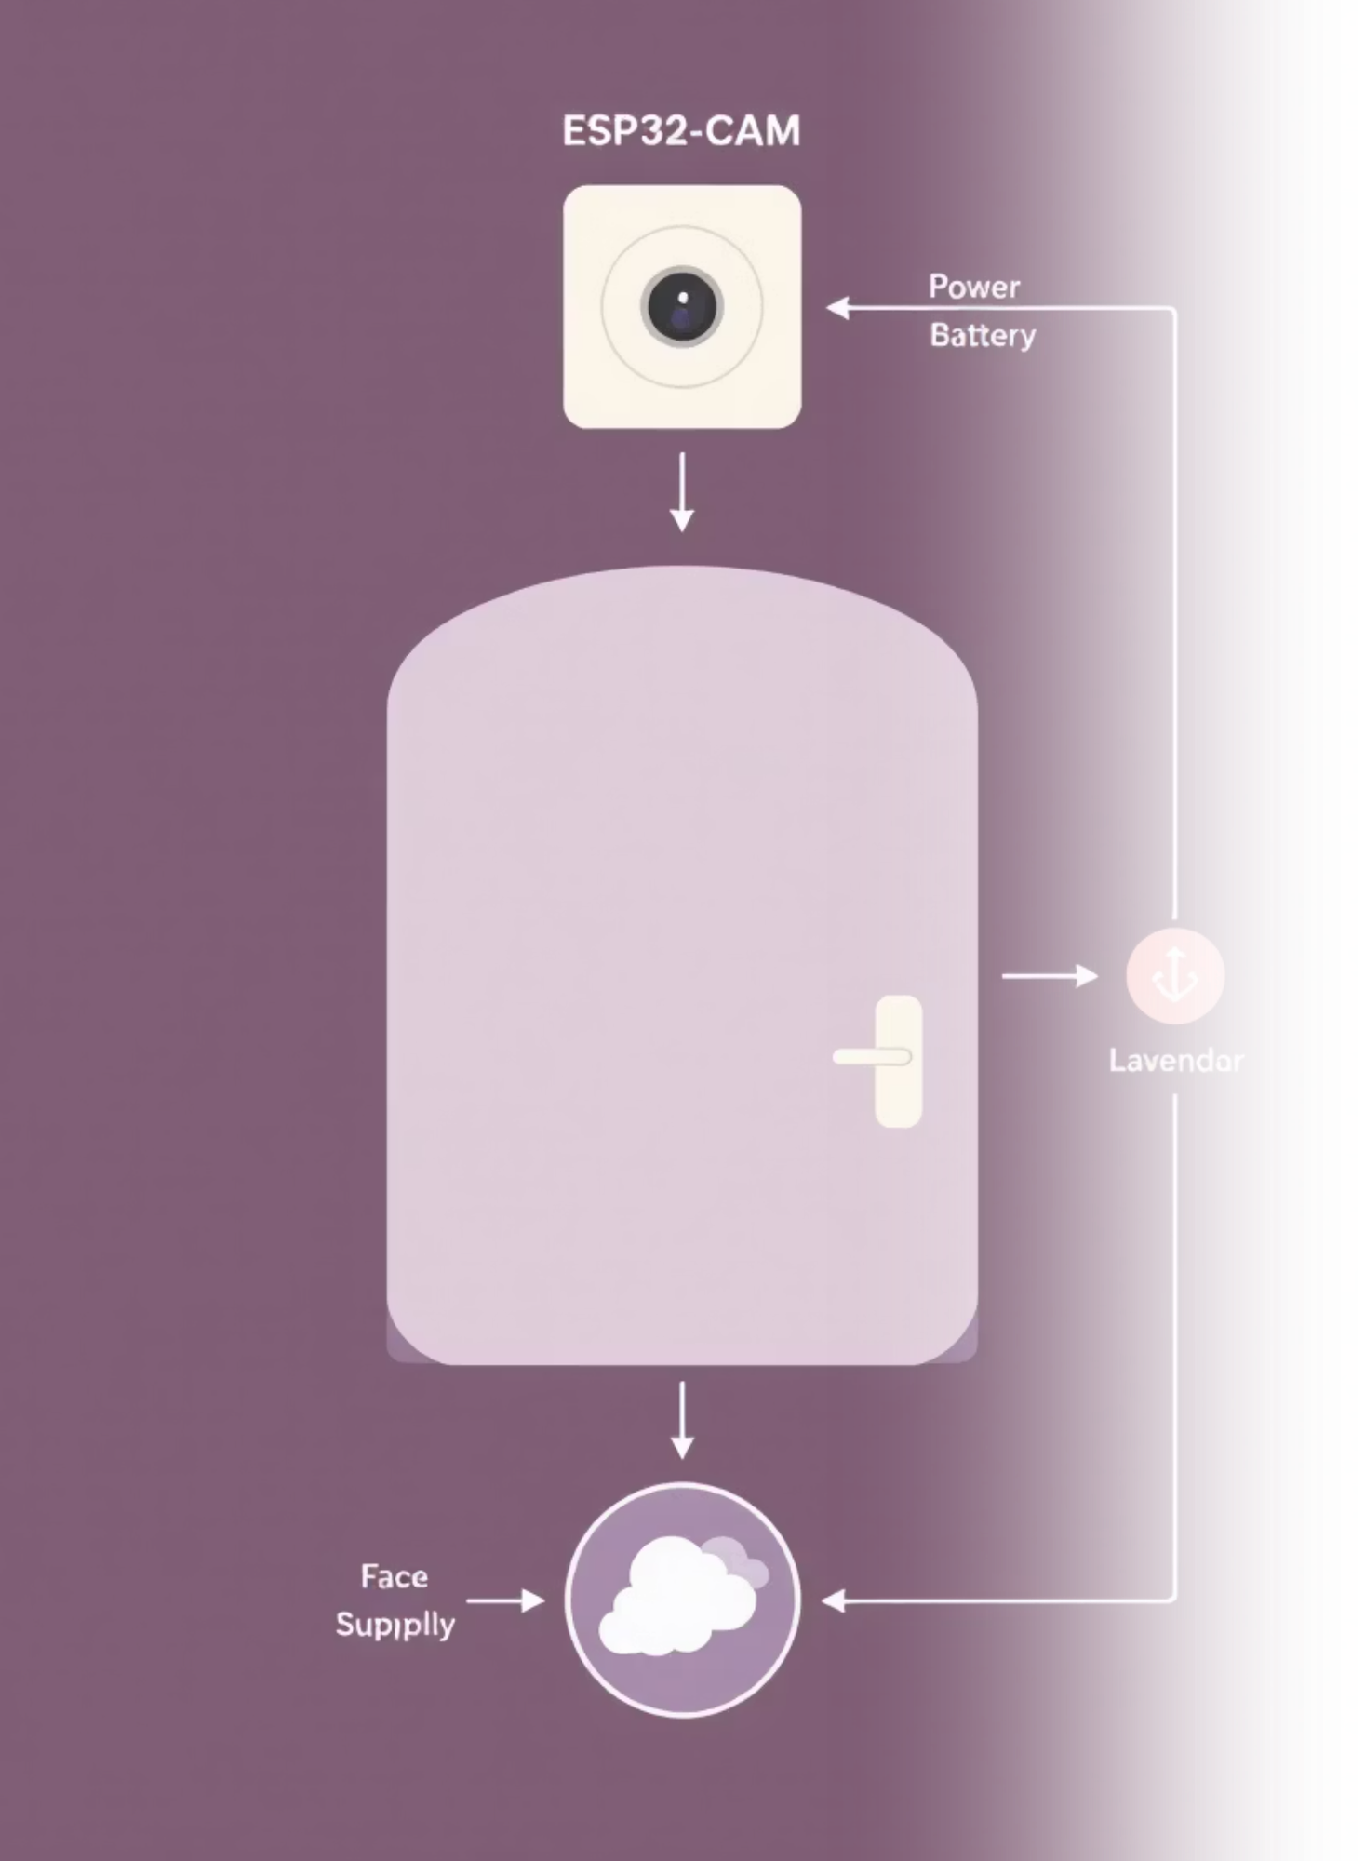
System Architecture
01
02
Image Capture & Processing
Local Template Matching
Extracted facial features are compared against locally stored authorised user templates in secure onboard database
ESP32-CAM captures facial images and performs real-time detection using integrated ESP-WHO library for accurate identification
03
Access Control Decision
Upon successful recognition within threshold parameters, relay module triggers electronic door lock to grant secure access

Slide 6

Hardware & Software Components
Hardware Specifications
Software Stack
ESP32-CAM Module
Development Environment
Dual-core MCU with OV2640 camera sensor and PSRAM for efficient image processing and storage
Arduino IDE with C++ programming and ESP-WHO library integration for face detection and recognition algorithms
Control & Power
Testing Framework
Relay module for door lock control with 5V DC power supply ensuring stable operation
Python simulation environment for workflow validation and system performance evaluation

Slide 7




Face Recognition Process Flow
Enrollment Phase
Detection & Analysis
Access Decision
Multiple face images captured, feature vectors extracted using ESP-WHO, then averaged to create unique template stored locally
Real-time face detection extracts features from live camera feed for comparison against enrolled user database
Template matching within threshold parameters triggers door unlock, maintaining privacy through offline processing

Slide 8
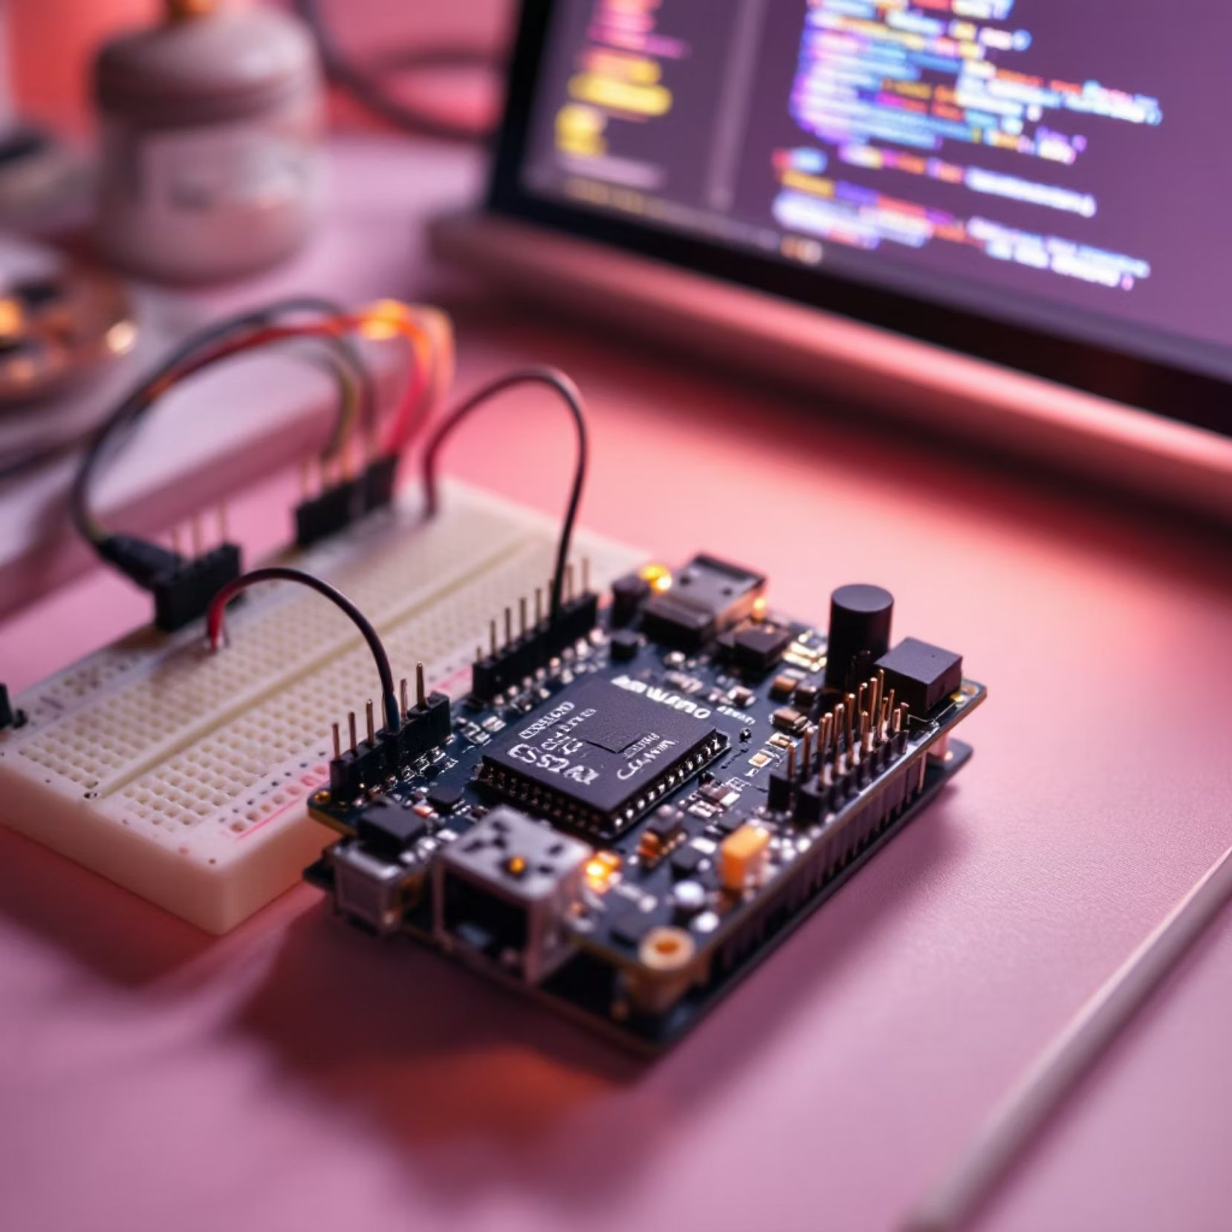
Implementation & Integration
Hardware Integration
Systematic connection of ESP32-CAM to relay module and electronic door lock with proper power distribution
Software Configuration
Camera initialisation and ESP-WHO library integration within Arduino IDE development environment
Testing Protocol
Python simulation validates complete workflow before deployment with comprehensive relay logic testing

Slide 9
Performance Results & Evaluation
>90%
~80%
<2s
160mA
Good Lighting Accuracy
Low Light Performance
Response Time
Peak Power Consumption
Maintained accuracy in challenging lighting environments demonstrating system robustness
Ultra-fast detection to unlock sequence ensuring seamless user experience
Excellent recognition performance under optimal illumination conditions with reliable user distinction
Efficient power usage suitable for battery-powered deployment scenarios

Slide 10

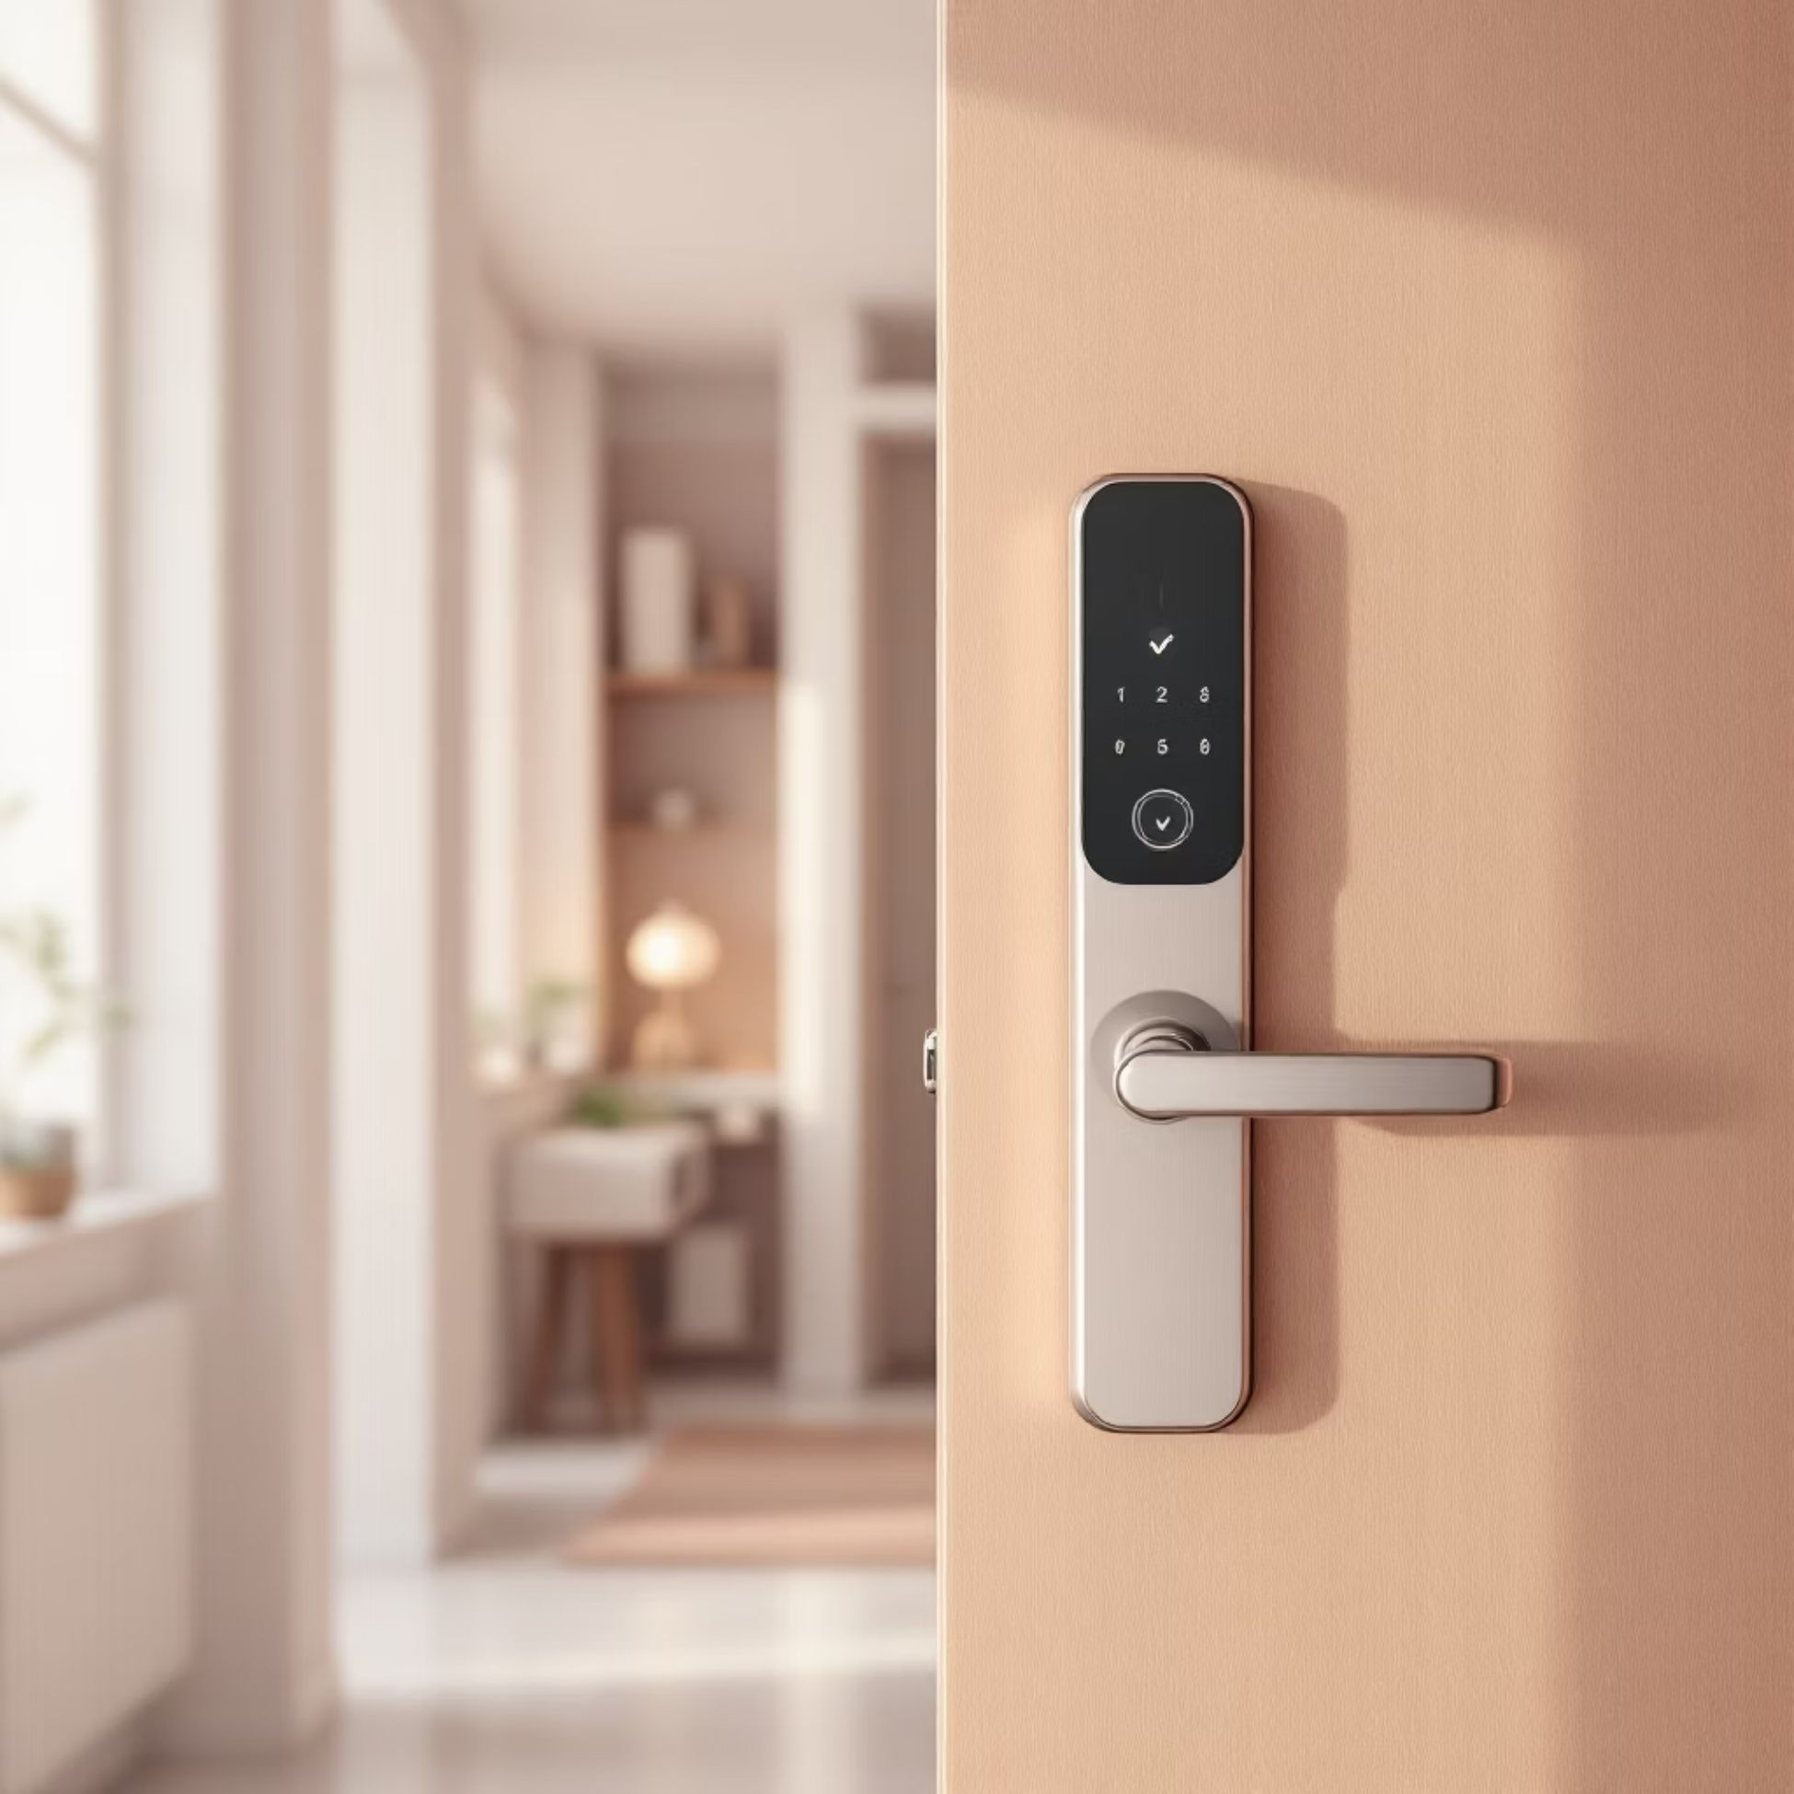

Future Enhancements & Conclusion
Planned Improvements
Project Success
Successfully demonstrated the power of edge AI in real-world security applications through cost-effective, privacy-preserving access control.
Enhanced Imaging
The system achieves fast, accurate results whilst providing a compelling alternative to cloud-based solutions, proving that sophisticated AI can operate efficiently on embedded platforms.
IR illumination for superior low-light performance and liveness detection to prevent spoofing attacks
Smart Integration
Mobile app for enrollment management and building system integration with expanded SD card storage

